Slide 1
CS5285 Information Security for eCommerce Lecture 7
Dr. Gerhard Hancke
CS Department City University of Hong Kong

Slide 2
Reminder of previous lecture
Authentication
What is needed for entity authentication?
Data origin authentication (sure who generated)
MAC/Encryption/Signature
Stops masquerade attacks
Freshness (is the message generated now?)
Nonce (Random or counter/sequence)/Timestamp
Stops replay
We looked at protocol examples…
Also remember the reflection attack

Slide 3
Today’s Lecture
Key Management
For all crypto we need keys (most important)
Symmetric key management
Asymmetric key management (Certificates)
CILO1,CILO2, CILO3 CILO4
(identify requirements, core threat, design and evaluation)
Credit to Keith Martin RHUL (borrowing few slides from his lecture notes – 6, 45-47)

Slide 4
Key Management

Slide 5
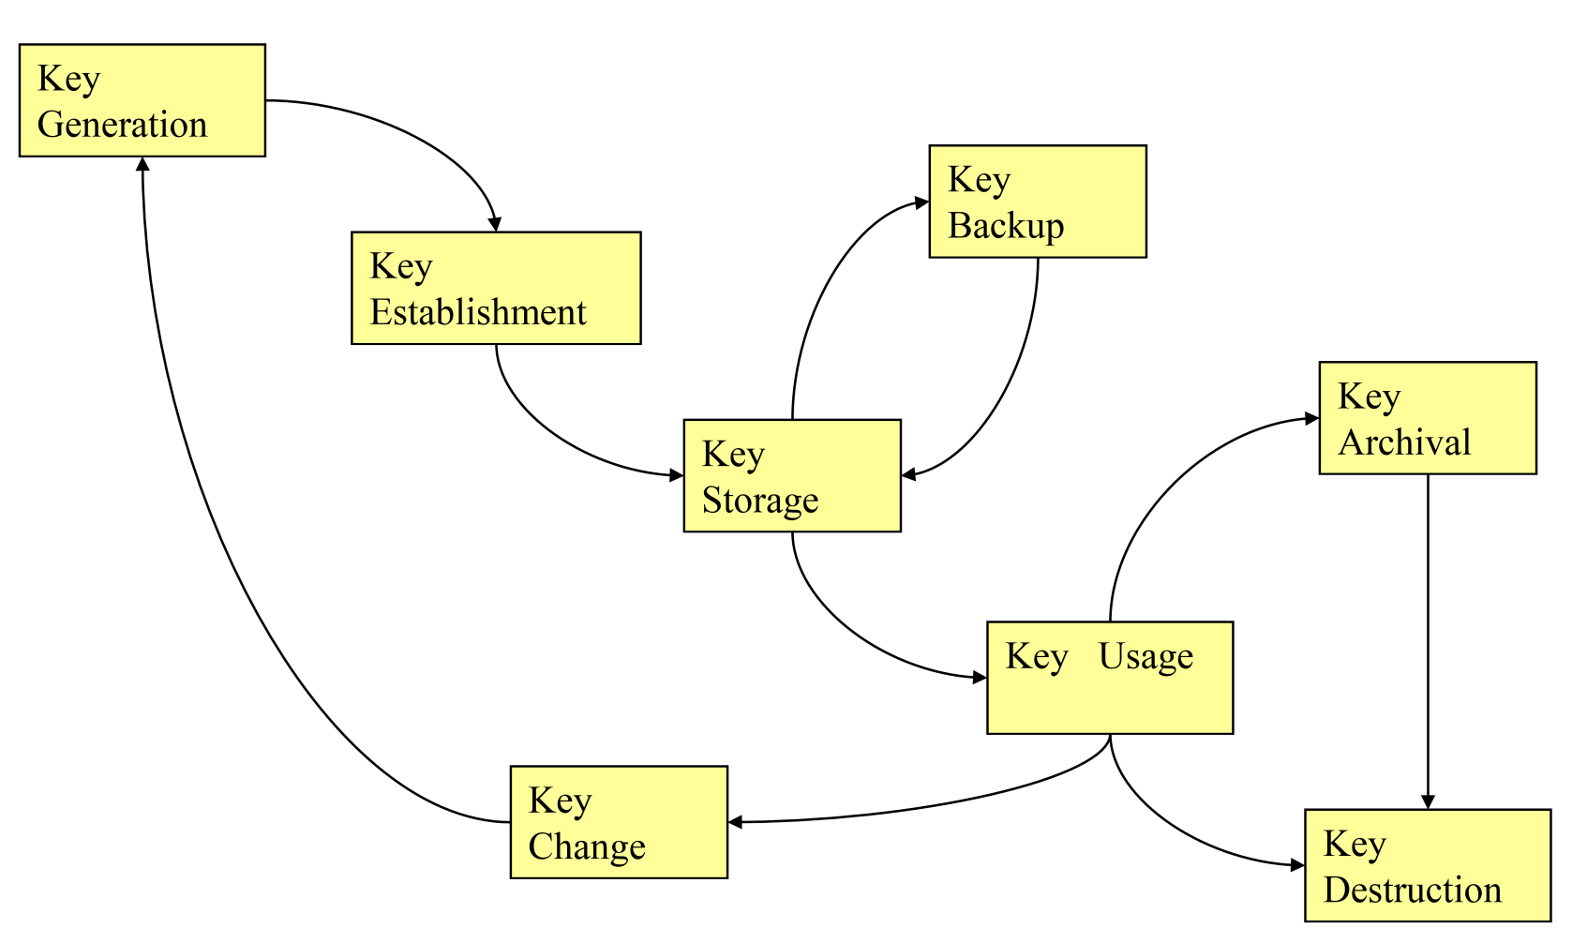
What is Key Management?

Slide 6
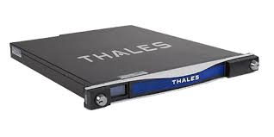
Hardware Security Module (HSM)
HSM is trusted part of system
Key generation and storage
Features:
Asymmetric Crypto (Signing/Encryption)
Symmetric Crypto (Encryption/MAC)
Hashes/KDF
Random numbers (True random, DRBG)
Secure networking (TLS), Tamper resistant

Slide 7
Symmetric-key protocols
The use of symmetric-key cryptography to produce a shared symmetric secret key.
The protocols can be classified as:
Directly communicating entities
Use of a Key Distribution Centre (KDC)
Use of a Key Translation Centre (KTC)

Slide 8
Directly communicating entities
The case where two entities directly communicate to establish keys.
Must take place using a secure channel (e.g. using an existing shared secret key or mutually trusted copies of each others’ public keys).

Slide 9
Distribution within a domain
Two possible cases:
asymmetric techniques used, or
symmetric techniques used.
In first case certificates may need to be distributed. Entities either contact their authority for certificates, or two entities may exchange them directly.
In second case - use a KDC or a KTC.

Slide 10
Distribution within a domain
Key Translation Centre (KTC): An entity trusted to transport keys between entities that share keys with the KTC.
Example of a key transport service.
Key Distribution Centre (KDC): An entity trusted to generate and distribute keys to entities that share keys with the KDC.
Arguably example of a key agreement service.

Slide 11
Key Translation Centre
Key
Translation
Centre
1
2
3
3
Entity A
Entity B

Slide 12
Key Distribution Centre
Key
Distribution
Centre
1
2
2
3
Entity A
Entity B

Slide 13
Terms for key management
Key establishment: Process of making a secret key available to multiple entities.
Key control: Ability to a choose a key’s value.
Key agreement: Process of establishing a key in such a way that neither entity has key control.
Key transport: Process of securely transferring a key from one entity to another.
Key confirmation: Assurance that another entity has a particular key.

Slide 14
Who has the key at the end?
We can set two requirements of key establishment
Implicit key authentication to A: The assurance for A that only another identified entity can possess a key. This is the basic security requirement.
Explicit key authentication to A: The assurance for A that only another identified entity possesses a key. This is a more stringent security requirement.

Slide 15
Key establishment mech. 6
Directly communicating entities.
A, B must share a secret key KAB.
R_{A} and R_{B} are nonces.
F_{A} and F_{B} contain keying material.

Slide 16
Key establishment mech. 6
M₁ = R_{B}
M₂ = Enc_{KAB}(R_{A}||R_{B}||B||F_{A}||Text1)
A
B
M₃ = Enc_{KAB}(R_{B}||R_{A}||F_{B}||Text4)
Key K typically a hash of F_{A} and F_{B}.

Slide 17
Key establishment mech. 9
TTP
M₂ = R′_{A}||R_{B}||B
M₃ = Enc_{KAT}(R′_{A}||F||B||Text1)||Enc_{KBT}(R_{B}||F||A||Text2)
M₁ = R_{B}
A
M₄ = Enc_{KBT}(R_{B}||F||A||Text2)||Enc_{KAB}(R_{A}||R_{B}||Text3)
B
M₅ = Enc_{KAB}(R_{B}||R_{A}||Text4)

Slide 18
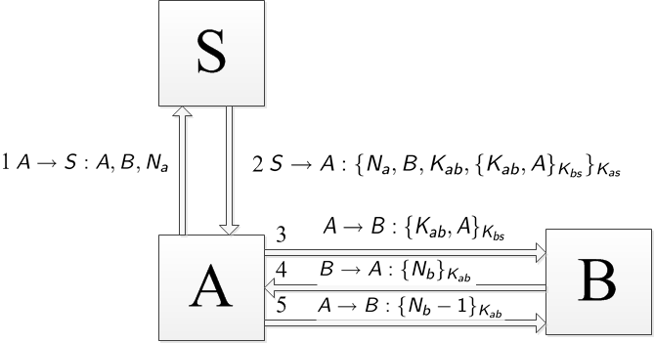
Remember from last lecture….

Slide 19
Public-key protocols
The use of public-key cryptography to produce a shared symmetric secret key.
The protocols can be classified as:
Key transport protocols (typically involving public-key encryption and digital signatures)
Key agreement protocols (indirectly specified and mostly based on the Diffie-Hellman protocol)

Slide 20
Notation
A and B are (identifiers for) two entities who wish to engage in an authentication protocol.
R_{A} is a random nonce generated by A.
Enc_{A}(X) denotes the encryption computed with A’s public key on the data X.
Sig_{A}(X) denotes the signature (with appendix) computed by A on the data X.

Slide 21
Key transport mech. 4
Key transport protocol.
A, B must have authenticated copies of each others public keys.
R_{A} and R_{B} are nonces.
The notion of keying material has been replaced with simply a key K.

Slide 22
Key transport mech. 4
M₁ = R_{B}
A
B
M₂ = B||R_{A}|| R_{B}||Enc_{B}(A||K)||
Sig_{A}(B||R_{A}|| R_{B}||Enc_{B}(A||K))

Slide 23
Last comment: Key hierarchies
Key are often organised in a hierarchy. Keys in one level used to protect or generate keys in next layer down.
Only lowest layer keys (session keys) used for data security.
Top layer key is master key. Must be protected with care.

Slide 24
Why use a key hierarchy
The more we use a key the more likely it is to be compromised….
Key establishment from nothing is hard…
Use top layer keys sparingly (long lifetime)
These keys used for only for key establishment
Low level keys used often (short lifetime)
Compromise of a session key of limited significance.

Slide 25
Example: Simple payment card
Closed system
Cards/readers all controlled by same entity
What keys do we need?
Card and reader need to share a key
Problem?
Reader cannot store each possible card key!
So give all cards the same key?
One compromised card = completely broken system!
The reader contains system master key
Card contains card key
Reader use master key and UID to derive card key
Reader and card communicate….
If card compromised then only limited damage.

Slide 26
Public Key (Certificate) Management

Slide 27
Remember….we would like to use signatures (and PKE)
M₁ = T_{A}||Sig_{A}(T_{A}||B)
A
B
M₂ = Enc_{A}(Data)

Slide 28
How do we verify a public key?
M₁ = ‘I am A’,T_{A}||Sig_{M}(T_{A}||B)
M₂ = Here is my (A) public key P_{M}
M
B
M₃ = ‘Hi A’, Enc_{PM}(Data)
How to verify A’s public key?

Slide 29
Digital Certificates
Public key encryption: encrypt using receiver’s public key
sender has to be sure that the public key used for encryption is indeed the receiver’s public key
Digital signature: verify a signature
Verifier has to be sure that the public key used for signature verification is indeed the signer’s public key
How can the encryptor / verifier be sure that the public key is authentic?
cryptanalysis
M
private key
Eve
M
M
C
encryption
decryption
Alice
Alice’s public key
private key
Alice’s Personal Homepage
How about posting the public key at a personal homepage?
How about sending the public key to the encryptor / verifier using email?

Slide 30
Digital Certificates
How it works:
There is an entity called Certification Authority (CA) in the system
CA has a public key which is ASSUMED to be well known
e.g. built-in, preinstalled into all the web browsers/operating systems
CA issues a certificate to each public key owner
The certificate bears (1) the public key owner’s identity, (2) the public key, (3) a validity period of the certificate and (4) the CA’s signature
By using the certificate, the CA vouches that the public key in the certificate is owned by the public key owner.
The CA publishes a Certification Practice Statement (CPS) that specifies the policies (including liabilities) governing the use of the certificates issued.
Only the CA can create a legitimate certificate
Only the CA can generate the signature in the certificate which requires the knowledge of CA’s private key
Anyone can verify the authenticity of the certificate using CA’s public key
Cert_{A} = (ID_{A}, PK_{A}, expiry-date, Sign_{CA}(ID_{A}, PK_{A}, expiry-date))

Slide 31
The Certification Authority
The “CA” is responsible for:
identifying entities before certificate generation
Generating user key or verifying user key
ensuring the quality of its own key pair,
keeping its private key secret.
The CA, before generating a certificate, ought to check that a user knows the private key corresponding to its claimed public key.

Slide 32
Who is involved?
Key
Generation
Registration
Authority
Certification
Authority
User
Directory

Slide 33
Some Remarks on Digital Certificates
Certificate authority (CA) is considered as a Trusted Third Party (TTP) that issues and signs certificates
Verifying CA’s signature in a certificate only verifies the binding validity between the public key and the identity in the certificate vouched by the CA
Verifying CA’s signature does not verify the identity of the source that the certificate comes from!
E.g. Alice may receive Carol’s certificate from Bob
Certificates are public!
Common format for certificates is ITU-T X.509.

Slide 34
X.509 certificates
X.509 is a standard format for public key certificates (and CRLs).
Standard first published in 1988.
Latest was published in 2021.
X.509 is part of the ITU-T Directory series of recommendations (ISO/IEC 9594).
Certificate format specified in ASN.1.
Note that the latest edition of X.509 covers ‘attribute certificates’ as well as public key certificates.

Slide 35
What’s Inside a Certificate (X.509)
e.g.
User Name (Common Name): www.hsbc.com.hk
Validity Period: Apr 16, 2010 – Apr 17, 2011
User’s Public Key: RSA (2048 bits)
Modulus (2048 bits): 30 82 01 0a 02 82 01…
Exponent (24 bits): 01 00 01
CA’s name (Issuer): VeriSign Class 3 Extended Validation SSL SGC CA
CA’s signature (Certificate Signature Value): Size: 256 Bytes / 2048 Bits
There are many other attributes: Certificate serial no., certificate version number, HSBC public key algorithm, CA’s signing algorithm, etc.
Cert_{A} = (ID_{A}, PK_{A}, expiry-date,… , Sign_{CA}(ID_{A}, PK_{A}, expiry-date, …))

Slide 36
Certificate Revocation
A CA is responsible for the lifetime management of certificates, including renewal, update and revocation.
Two methods for managing revocation:
use of Certification Revocation Lists, i.e. lists of revoked certificates, signed by CA
providing an on-line validation service.

Slide 37
CRLs
Each CRL entry contains the serial number of the X.509 certificate being revoked.
CRLs must be updated at regular defined intervals, enabling CRL user to verify that they are in possession of the ‘latest’ version.

Slide 38
Online certificate status protocol
Online Certificate Status Protocol (OCSP) enables certificate status to be queried.
OCSP may provide more timely revocation information than is possible with CRLs.
Entity issues status request to TTP and suspends acceptance of certificate until TTP gives response.
The protocol specifies data exchanged between entity checking certificate status and the TTP providing that status.

Slide 39
PKI
Public Key Infrastructure (PKI) consists of all pieces needed to securely use public key cryptography
Key generation and management
Certification authorities, digital certificates
Certificate revocation lists (CRLs)
No general standard for PKI
We consider a few models of PKI

Slide 40
PKI Trust Models
Monopoly model
One universally trusted organization is the CA for the known universe
Big problems if CA is ever compromised
Big problem if you don’t trust the CA!
Should country X trust CA in country Y?
Where and who would this CA be?

Slide 41
PKI Trust Models
Anarchy model
Everyone is a CA!
Users must decide which “CAs” to trust
Used in PGP (Pretty Good Privacy)
www.pgpi.org
Why do they call it “anarchy”?
Suppose cert. is signed by Frank and I don’t know Frank, but I do trust Bob and Bob vouches for Frank. Should I trust Frank?
Suppose cert. is signed by Frank and I don’t know Frank, but I do trust Bob and Bob says Alice is trustworthy and Alice vouches for Frank. Should I trust Frank?

Slide 42
PGP – Anarchy Model
Unstructured
Suppose a public key is received and claimed to be Alice’s.
The public key and Alice’s identity are signed by some others (CAs). Each signature is considered as a certificate:
Example: if my trust in certificates issued by Bob, Carol, and Dave (whose public keys I already have valid copies) are 1/2, 1/3, 1/3, respectively (and I don’t have Eve’s public key), then the above public key for Alice is considered as trust-worthy as 1/2 + 1/3 + 1/3 ≥ 1
Scalability weakness
Trust is not transferrable. Alice trusts Bob, Bob trusts Carol, does not necessarily mean that Alice trusts Carol.
It may be cumbersome for one to get adequate certificates so that one’s public key can be trusted.
Cert_{Bob}(Alice), Cert_{Carol}(Alice), Cert_{Dave}(Alice), Cert_{Eve}(Alice)

Slide 43
PKI Trust Models
Structured
Multiple trusted CAs
Used today
Browser may have tens of root CAs’ public keys build-in
User can decide which CAs to trust (by default, you trust what the browser said to trust)

Slide 44
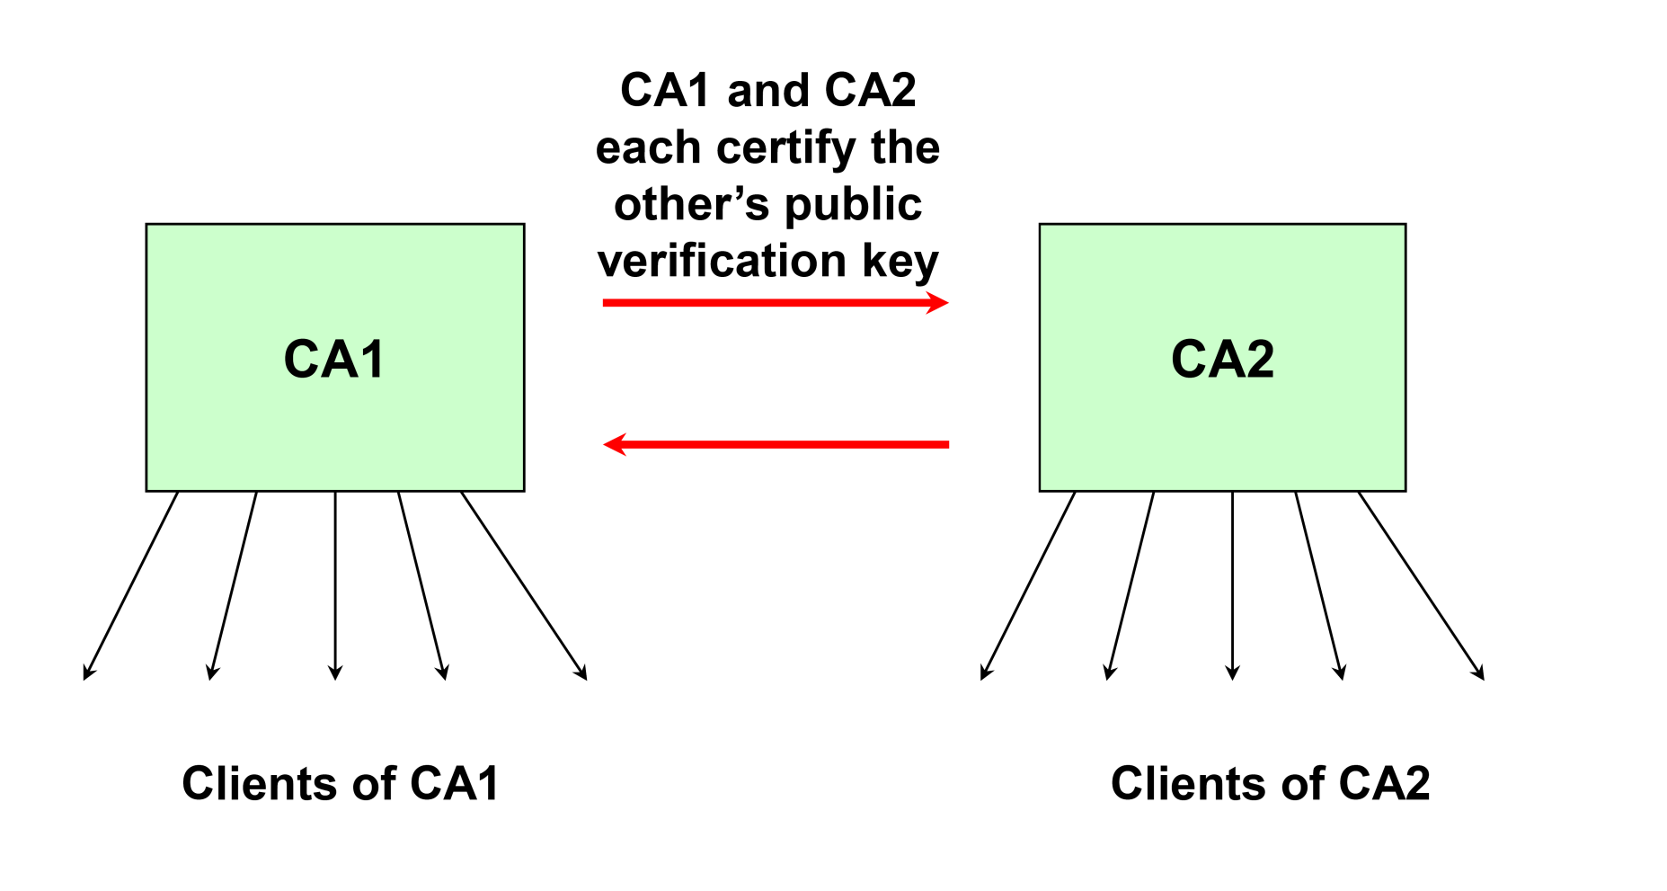
Cross certification

Slide 45
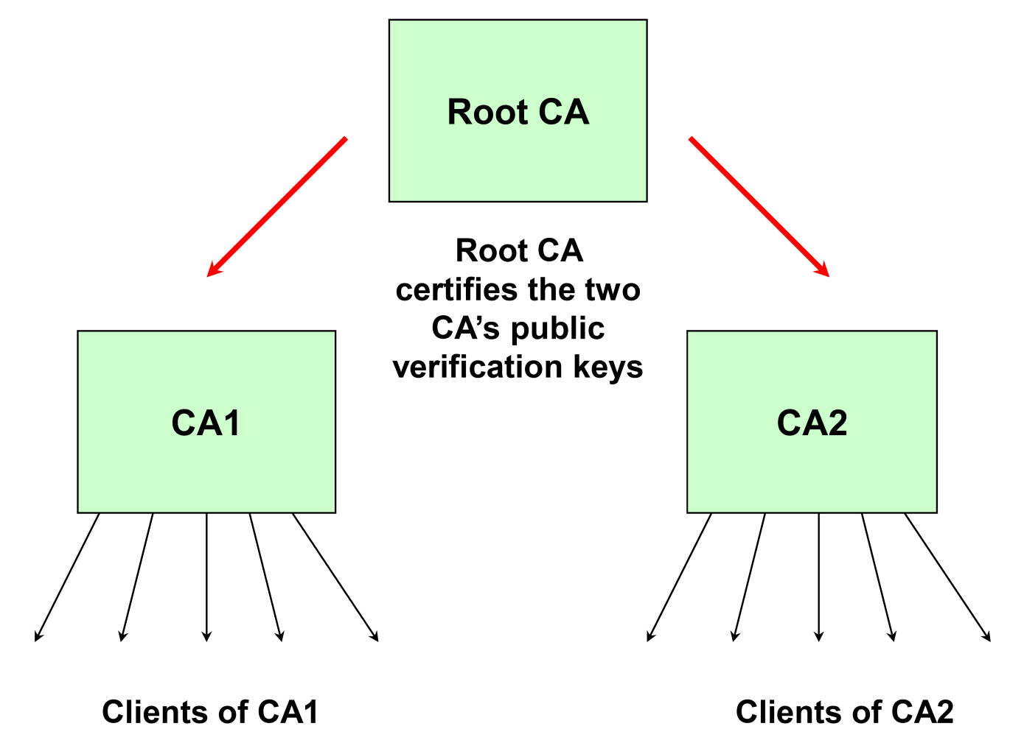
Certificate Hierarchy

Slide 46
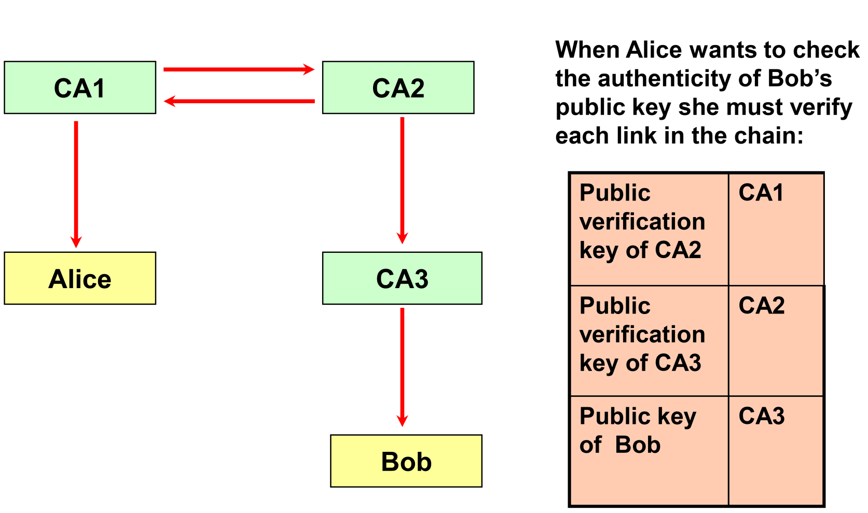
Certificate Chains

Slide 47
How to Use PKI – Secure Web Browsing
Internet
Web Server
Web Browser
(PK, SK)
Cert = < ID_{server}, PK, expiry-date, Sign_{CA}(…) >
The web browser has the CA’s public key built in.
The legitimacy of the web browser software becomes crucial for ensuring the security of digital certificates
A certificate is NO more secure than the security of the web browser
In practice, each browser trusts multiple CAs rather than just one
Exercise: find out the number of CAs that your browser trusts

Slide 48
Payment Card Example
EMV credit cards
Open payment (different card vendors and payment terminals different systems)
Authentication of card/transaction data
Card vendors not giving terminal vendor their master symmetric key!!! So what now?
How can we authenticate if we do not trust others with our secret keys?
Use public key crypto – use certificates!
Step 1: Card signs transaction data and also sends the card’s certificate
Card certificate signed by card vendor
Step 2: Terminal has card company certificate, so verifies card certificate, then verifies card signature

Slide 49
PKI and e-Commerce
A PKI can be used to ensure secure transactions on the Internet. This is especially important to foster e-commerce development.
PKI implementation provides a solution for the business/legal aspects of electronic transactions.
To bring such transactions to equivalent footing as traditional transactions some countries have established legislation governing electronic transactions.
For example, in Hong Kong, the ‘Electronic Transactions Ordinance’ (http://www.ogcio.gov.hk/eng/eto/eeto.htm) was established in January 2000.
Give legal status to electronic records and transactions, digital signatures.
Give recognition to the first public CA, which went into operation in February 2000: Hong Kong Post e-Cert.

Slide 50
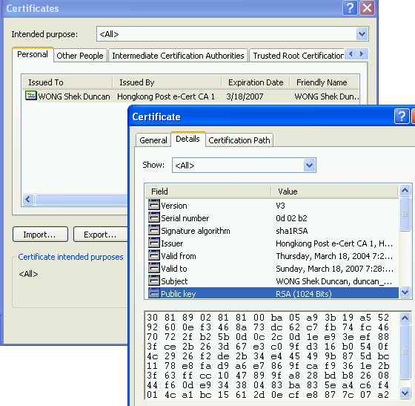
Personal Certificates
Why want personal certificates?
send signed email messages
allow your peers to send encrypted emails to you
Hongkong Post e-cert (Hong Kong’s CA)
HK$ 50 for a year
E-cheque
Online (some banks login, tax returns, etc).

Slide 51
PKI Implementation Hurdles
PKI does have great success, e.g. web security/TLS
PKI is still not widely used for personal/business transactions. Good security and structural aspects but:
Not easy to understand by laymen.
Users have little incentive to get certificates as most applications are not PKI-enabled
Legal recognition largely untested
Very few real court cases (world-wide).
Must have certificate from recognised trust service provider
Very small number of these
In Hong Kong, most of the applications support both personal certificate and password-based authentication methods.
Only two accepted CAs

Slide 52

Key management is boring!
Maybe, but it is very important!
Without keys we have no security services

Slide 53
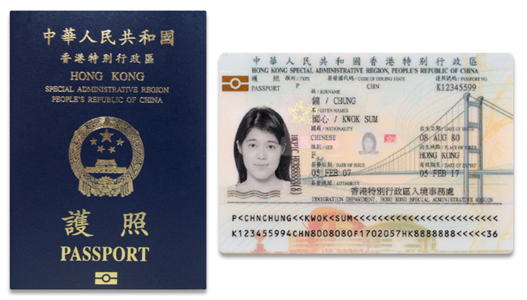
E-passport
Sometimes need to design for interesting case
E-Passports (governed by ICAO)
Passive Authentication
Data signed
Who needs to verify?
Basic access control
Verify symmetric key
Who needs this key?

Slide 54
E-passport c’ntd
Example of key management things going wrong!
Basic access control key size
Theory: Serial no, birthday, expiry date = 50 bits
Reality: Predictable values, so closer to 25 bits
Had to fix: Alphanumeric random serial no
Passive authentication verification
A few years after adoption not a lot of people were actually verifying the signature using country certificate

Slide 55
Advanced Threats
Stuxnet was a multi-stage malware targeting intermediate systems (MS Windows,Siemens PCS7, WinCC) to reach its main objective (Siemens S7 PLCs).
Stuxnet's delivery mechanism was based on the Microsoft Windows platform, but its primary objective was industrial control systems
The control systems targeted were highly specific
A number of zero-day exploits were deployed

Slide 56
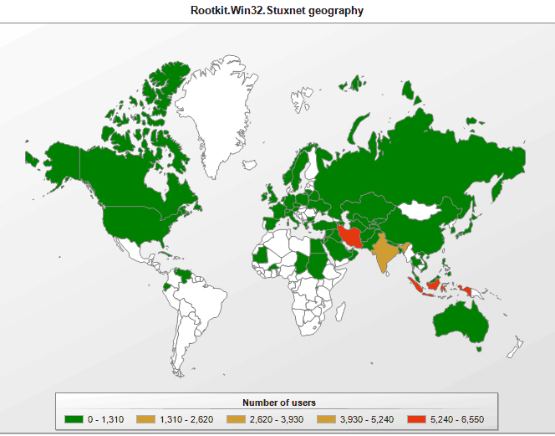
STUXNET (1)
Snapshot of STUXNET infection (Sept 2010)
by University of Maryland.

Slide 57
Stuxnet (2)
Stuxnet uses different mechanisms, including hiding itself on removable storage media (to get to air-gapped systems)
A device driver is installed looking for files matching the characteristics of the Stuxnet payload.
What do you need to install driver on Windows?
Private key of trusted vendor
Jan-June 2010(Realtek), Verisign revokes certificate
July…(JMicron Tech)
Core part of this issue: two compromised keys

Slide 58
The end!
?
Any questions…

